Slide 1

Database Theory and Applications for Biomedical Research and Practice BMIN 502 / EPID 635 Week 1: Introduction and simple database design
John H. Holmes, PhD

Slide 2
Objectives for today
You will learn:
The difference between data, information, knowledge, and wisdom
About the systems approach to data and information
The basics of database architectures and what informs them
The basics of data modeling

Slide 3
First things first… What is (are) data, anyway???

Slide 4
The Information Spectrum
Data
Information
Knowledge
Wisdom

Slide 5
Another way of looking at this
Data
Information
Knowledge
Wisdom

Slide 6
A Systems Approach to Information

Slide 7
Information Systems
Typically centered around a database
Provide a means for input of data
Provide some mechanism for data manipulation
Provide a means for data output
May include hardware and software
Usually involve users in some way

Slide 8
Information Systems: Examples
Databases (of all kinds)
Patient records
Laboratory information systems
PACS
Point-of-care systems
Billing systems
Registries

Slide 9
You can’t have information if you don’t have data!

Slide 10
Considerations about Clinical Data

Slide 11
Forms of Clinical Data
Structured
Unstructured
Image
Waveform

Slide 12
Types of clinical data: Structured Data
Typically represented as discrete values in a fixed format
Can be obtained from instrumentation
Laboratory, diagnostic, monitoring, etc.
Can be selected from possible response options
Checkboxes, pulldowns, lists, etc.
Examples
Demographics
Lab values
Medications
Disposition

Slide 13
Types of clinical data: Narrative Data
Admission notes
Histories and Physicals
Progress notes
Radiology reports
Consult notes
Chief complaints
Discharge summaries
Nurse’s notes
Patient-reported communications
…

Slide 14
Types of Clinical Data: Images
Illustrations
Radiologic images
Photographs

Slide 15
Types of Clinical Data: Waveforms
ECG
EEG
Arterial pressure monitoring
Actigraph monitoring

Slide 16
Functions of Clinical Data
Basis of the historical record
Communication between providers
Anticipation of future problems
Provide a legal record
Support clinical research

Slide 17
All of these forms and functions (and there are others) pose challenges for database systems design, maintenance, and data analysis

Slide 18
Introduction to Ontologies

Slide 19
Some definitions (Source: ISO Standard 1087)
Object
Any part of the perceivable or conceivable world
Name
Designation of an object by a linguistic expression
Concept
Unit of thought constituted through abstraction on the basis of properties common to a set of objects
Term
Designation of a defined concept in a special language by a linguistic expression

Slide 20
More definitions…
Terminology
Set of terms representing the system of concepts of a particular subject field
Taxonomy
A classification, employing a terminology
Nomenclature
System of terms that is elaborated according to pre-established naming rules
Ontology
Explicit specification of a conceptualization

Slide 21
So, what are ontologies?
Formally, an ontology is the statement of a logical theory
Definitions associate the names of entities in the universe of discourse (e.g., classes, relations, functions, or other objects) with human-readable text describing what the names mean, and formal axioms that constrain the interpretation and well-formed use of these terms.
Thus, ontologies are computable taxonomies

Slide 22
Let’s look at an ontology used in a drug-related context…

Slide 23
RxNorm National Library of Medicine http://www.nlm.nih.gov/research/umls/rxnorm/overview.html
Standardized nomenclature for clinical drugs
Standard names for drugs linked connected to varying names of drugs present in many different controlled vocabularies within the Unified Medical Language System (UMLS) Metathesaurus
Connections facilitate interoperability among computerized systems that process clinical drug data

Slide 24
RxNorm, contd.
RxNorm is organized around normalized names, or terms, for clinical drugs
The terms contain information on ingredients, strengths, and dose forms
The goal of RxNorm is to allow various systems using different drug nomenclature to share data efficiently

Slide 25
The scope of RxNorm
Contains the names of prescription and many nonprescription formulations approved for use in the United States, including the devices that administer the medications

Slide 26
How do the links work?
Links from clinical drugs (branded and generic) to:
Active ingredients
Drug components (active ingredient + strength)
Related brand names
National Drug Codes
RxNorm links its names to many of the drug vocabularies commonly used in pharmacy management and drug interaction software and mediates between them
First Databank
Micromedex
MediSpan
Multum

Slide 27
An example
Two preparations
Acetaminophen 500 MG Oral Tablet for a generic drug name
Acetaminophen 500 MG Oral Tablet [Tylenol] for a branded drug name
Acetaminophen 500 MG Oral Tablet is related to Acetaminophen 500 MG Oral Tablet [Tylenol]
Both have relationships to Acetaminophen, Acetaminophen 500 MG, and Oral Tablet.
Within the UMLS Metathesaurus, Acetaminophen 500 MG Oral Tablet and Acetaminophen 500 MG Oral Tablet [Tylenol] will each be linked to the different names that are used for these entities in other vocabularies

Slide 28
RxNav
Java-based application that connects to the RxNorm server at NLM
Allows users to query the RxNorm database by any of its components (ingredient, clinical drug, brand name, etc) and displays all the information related to a given component on a single page
https://mor.nlm.nih.gov/RxNav/

Slide 29
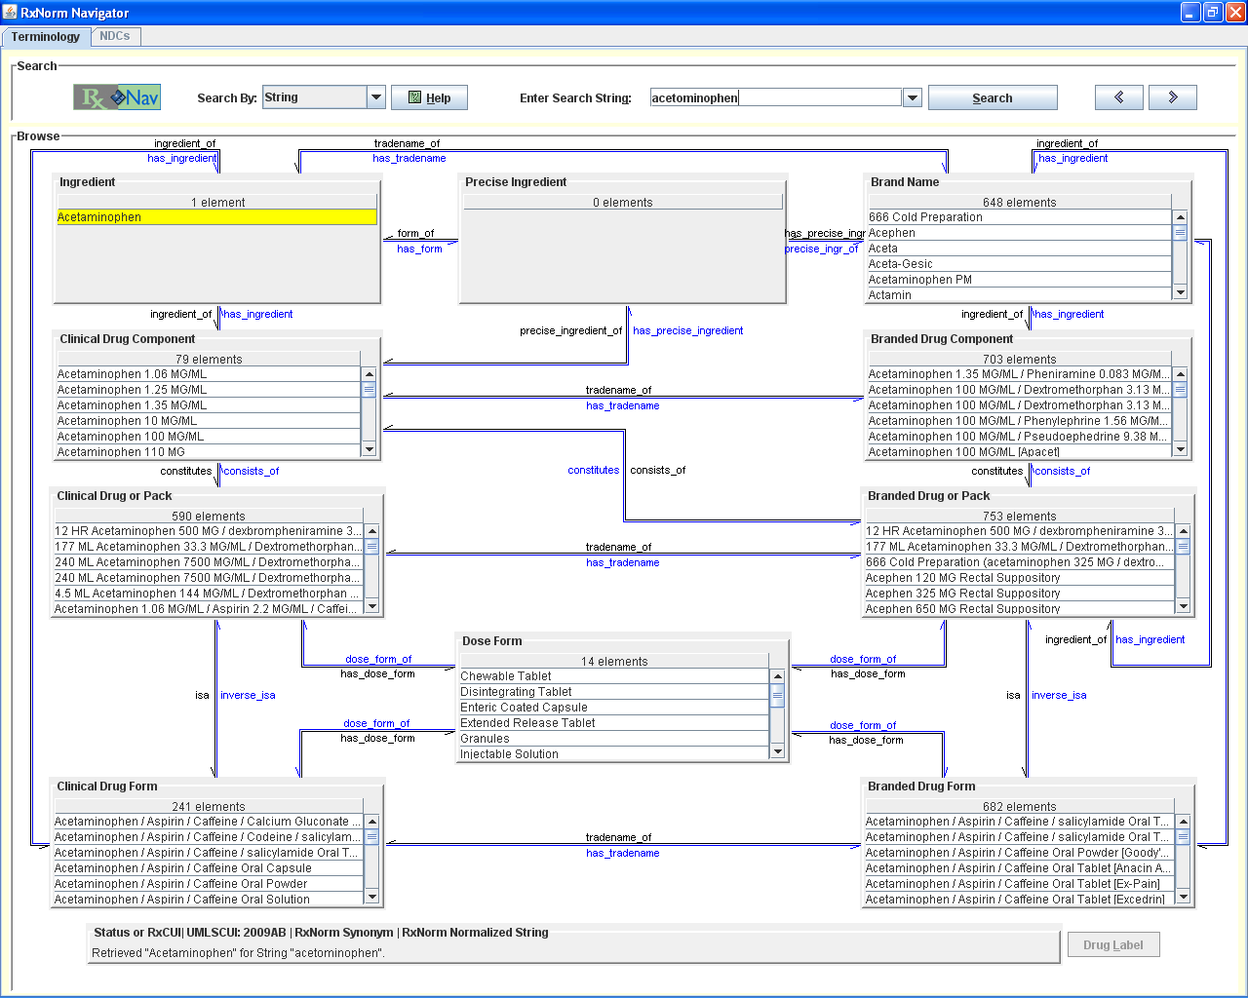

Slide 30
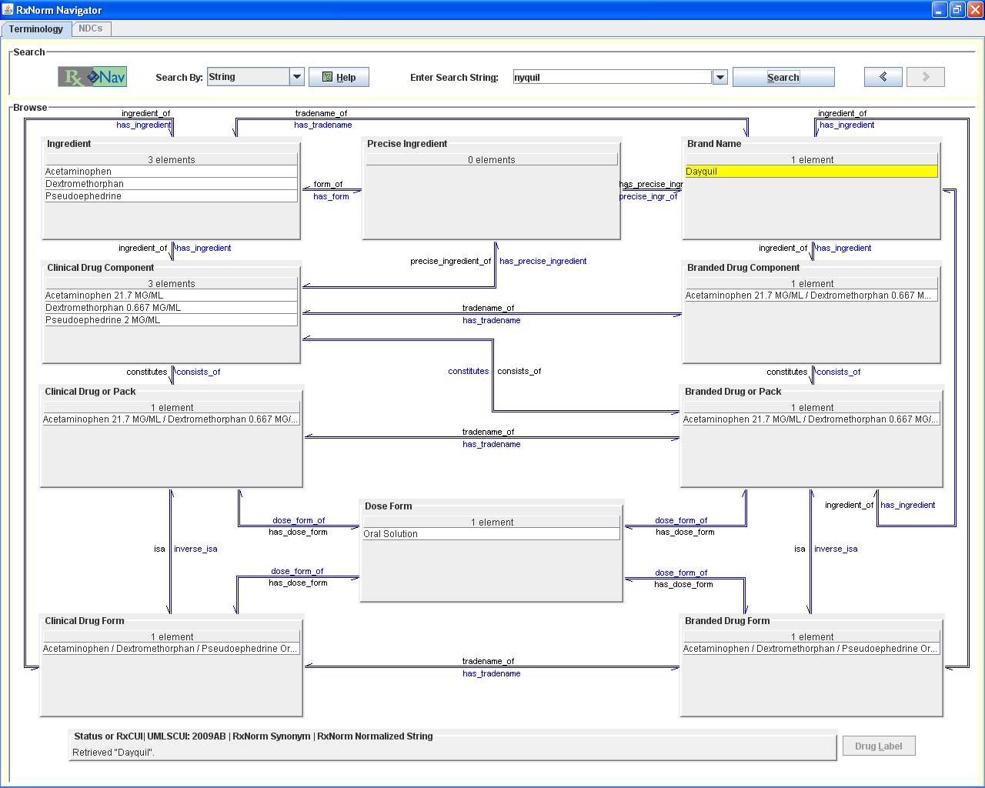

Slide 31
Introduction to Databases

Slide 32
What is a database?
Logically coherent collection of data with some inherent meaning
Databases are designed, built, and populated with data for a specific purpose, for an intended group of users
Represent some aspect of the real world

Slide 33
Some database platforms
Relational databases
Microsoft Access
FileMaker
Oracle
MySQL
Hierarchical-relational hybrid
REDCap
Graph
Blackfynn
Neo4j

Slide 34
The relational model
First developed in 1969
Data represented in:
Relations (tables), which are composed of:
Tuples (records, rows), which are composed of:
Columns (fields, variables)
Facilitates
Rapid database design
Database design that reflects epistemology of the real world
Compact and efficient data entry and retrieval
Preservation of data integrity and security

Slide 35
A relation

Slide 36
Databases don’t grow on trees…
They need to be designed, based on robust modeling methods

Slide 37
Introduction to Data Modeling
Notes:
37

Slide 38
What is a model?
Abstraction of a physical entity which makes it easier to grasp that entity’s complexity and detail
A model behaves like all or part of the physical entity it represents

Slide 39
Examples of models
Architectural and engineering
Process models
Statistical models
Data models

Slide 40
Types of models in building a database
Conceptual
Logical
Physical

Slide 41
Conceptual models
Narrative
High-level description
Not highly structured
Not linked to implementation platforms

Slide 42
Logical models
Graphical
High-level to moderately low-level
Highly structured
Not linked to implementation platforms

Slide 43
Physical models
Low-level
Highly detailed
Wedded to specific implementation platforms
We will come back to these in a couple of weeks!

Slide 44
Typical database development
Conceptual model
Narrative description
Logical model
Graphical model
Physical model
Database
REDCap
MySQL
Graph
Etc.
Specifications

Slide 45
Logical data modeling concepts
Entities
Things about which data are recorded
Entity attributes
Static properties of entities (“fields” or “variables”)
Relationships
Abstraction of associations between entities
Entity instances
A concrete representation of an entity
Schema
Text-based description of an entity

Slide 46
Thus…
Entity
A patient
Entity attributes
Study ID
Date of birth
Relationship
A patient has one or more admissions
Instance
The patient (John Smith, e.g.)
Schema
We’ll get to that next week!

Slide 47
The Entity-Relationship Model
Logical model of
Entities represented in a data world
Relationships between those entities
E-R models help us to understand
What we are collecting data about
What we are collecting
Characteristics of what we are collecting
How to avoid bad database designs

Slide 48
Entities
Abstract “things” (people, places, events, etc.) about which data are recorded
Examples
Patient (not “John Smith”, but “a patient”)
Admission (not the one on 5/10/2014, but “an admission”)

Slide 49
Entity Attributes
Equivalent to variables or fields
Can be typed (text, numeric, date, etc.)
Can be multiply instantiated within an entity instance (e.g., a patient can have >1 diagnosis)
Can be used to identify unique records

Slide 50
Key Entity Attributes
Candidate keys
Attributes or sets of attributes that can uniquely identify an instance of an object
Primary key
The candidate key that was chosen to be the attribute or set of attributes that uniquely identifies an instance of an object
Foreign key
An attribute of an object which is a primary key in another object

Slide 51
What makes a good key?
Must be unique from instance to instance
Can consist of more than one attribute!
E.g.: ID+DISCH_DX
To identify a unique instance of a diagnosis code for a specific subject, you need both the subject’s ID number and the diagnosis code!

Slide 52
Some examples of bad keys
Social Security Number
Medical Record Number
Subject Name
More…

Slide 53
How do we identify a record in a database? Primary keys!
Primary key: The attribute or set of attributes that uniquely identifies an instance of an entity
Single-attribute Primary Key
Examples: Study_ID
Study_ID+Discharge_Date
Multiple-attribute (compound) Primary Key

Slide 54
Relationships
Abstraction of a set of associations between entities that holds systematically when applied to the real world
Can be classified into two basic types, depending on the number of instances participating in each instance of the relationship (cardinality)
One-to-One
One-to-Many
Many-to-Many

Slide 55
One-to-one (1:1) Relationships
A single instance of an entity can relate to one and only one instance of another
Example: An individual patient can have only one clinic visit completed for a study

Slide 56
One-to-one relationship
NB: Primary Keys are underlined!
Patient
Patient ID
Sex
DOB
(Other attributes…)
Clinic Visit
Patient ID
Visit Date
(Other attributes…)
Has
NB: A single-headed
arrow indicates a 1:1
relationship

Slide 57
One-to-many (1:M) Relationships
A single instance of an entity can relate to one or more instances of another
Example: An individual patient has one or more hospital admissions

Slide 58
One-to-Many Relationships
Patient
Patient ID
Sex
DOB
(Other attributes…)
Admission
Patient ID
Admission Date
LOS
(Other attributes…)
Has
NB: A double-headed
arrow indicates a 1:M
relationship

Slide 59
Multivalued attributes
A single attribute of an entity is repeated within that entity
Thus, a type of 1:M relationship
Example: An individual patient can have one secondary discharge diagnosis, or many

Slide 60
Multivalued Attributes
Patient
Patient ID
Sex
Primary_Dx
(Other attributes…)
Has
Patient ID
Discharge Dx
NB: A double-headed arrow pointing to
A circle containing attribute names
indicates a multivalued attribute

Slide 61
Many-to-Many Relationships
A patient can be seen by one or more house officers
Housestaff repeats for each patient!
A house officer can see one or more patients
Patient repeats for each house officer!
Housestaff
Housestaff ID
Service
PG Year
(Other attributes…)
Patient
ID Number
Admit date
Discharge date
Is seen by
Sees

Slide 62
How to model the Many-to-Many relationship
Housestaff
Housestaff ID
Service
PG Year
(Other attributes…)
Patient
ID Number
Admit date
Discharge date
Sees
Is seen by
Patient-Housestaff
ID Number
Housestaff ID
Correlation Table

Slide 63
Cardinality: A Summary

Slide 64
Relationship Modality
Used to indicate whether or not an entity must participate in a relationship
Required: A patient must have at least one hospitalization
Optional: A patient may have one or more hospitalizations

Slide 65
Modeling an optional 1:M
Patient
Patient ID
Sex
DOB
(Other attributes…)
Admission
Patient ID
Admission Date
LOS
(Other attributes…)
Has
NB: An open circle at the
foot of the relationship line
indicates an optional relationship

Slide 66
Why do we care about optional relationships?
During data entry, maintenance, and analysis, we want to know whether or not to expect an instance!

Slide 67
Composite attributes A very thorny problem!
Composite attribute: A single field or attribute that represents two or more concepts
Example: An attribute where the first two digits represent a study site, and the last three the subject ID: 01123
The problem
In order to count the number of subjects at site 01, you would need to parse “01123”

Slide 68
So how do you create an E-R model???
Make a list of all of the things about which you will collect data
These are your candidate entities
For each candidate entity, list the attributes, identifying primary keys, multivalued attributes, and taking care to ensure all attributes are atomic
Draw the relationships between the entities
Identify and name the 1:1 and 1:M relationships

Slide 69
Assignment 1: Create an Entity-Relationship Diagram for the ABIC Registry
Submit as a Word or Powerpoint document to Canvas by 9am 1/29

